Slide 1
Virtual Machines
Docker

Slide 2
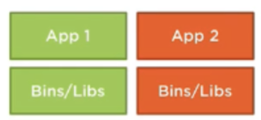

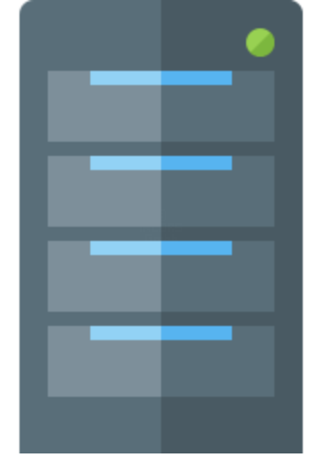
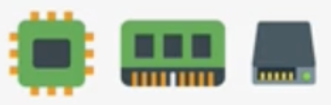

History of Virtual Machines
1 app = 1 server

Slide 3
History of Virtual Machines
1 app = 1 server

Slide 4
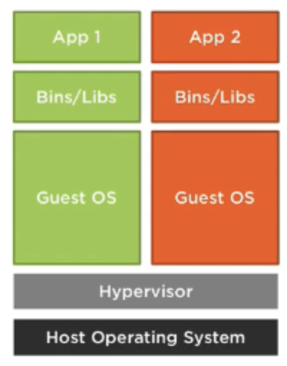
History of Virtual Machines
1 app = 1 server
Hypervisors (VMWare)

Slide 5
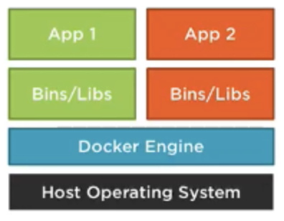
History of Virtual Machines
1 app = 1 server
Hypervisors (VMWare)
Docker

Slide 6
VMs
Docker
Creates virtual machines from underlying hardware
Each VM consumes Physical resources
Its own memory, CPU, storage, USB, network interfaces, etc.
Has its own Guest OS, runs independently from the host
Slow, takes time to start, stop, build, etc.
Images are heavy (1GB, 2GB, etc)
Bundles an application and everything it needs to run inside a container.
Each container consumes OS resources No abstraction of hardware resources
Single Host OS
Fast at starting and stopping containers
Images are light (Megabytes)
Easier to work with microservices

Slide 7

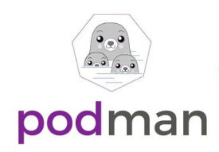
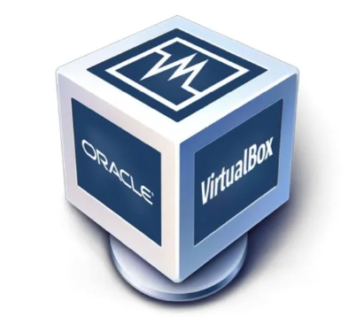
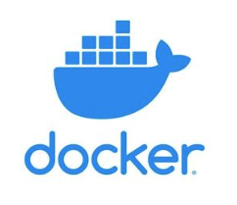
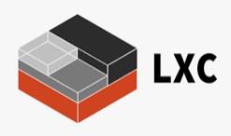
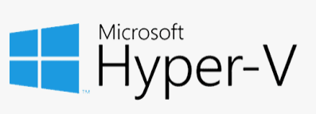
Virtualization - VMs
Containerization - Containers

Slide 8
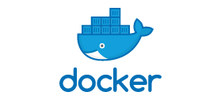

Slide 9
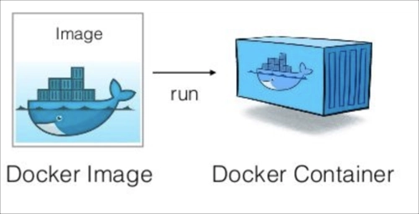

Slide 10
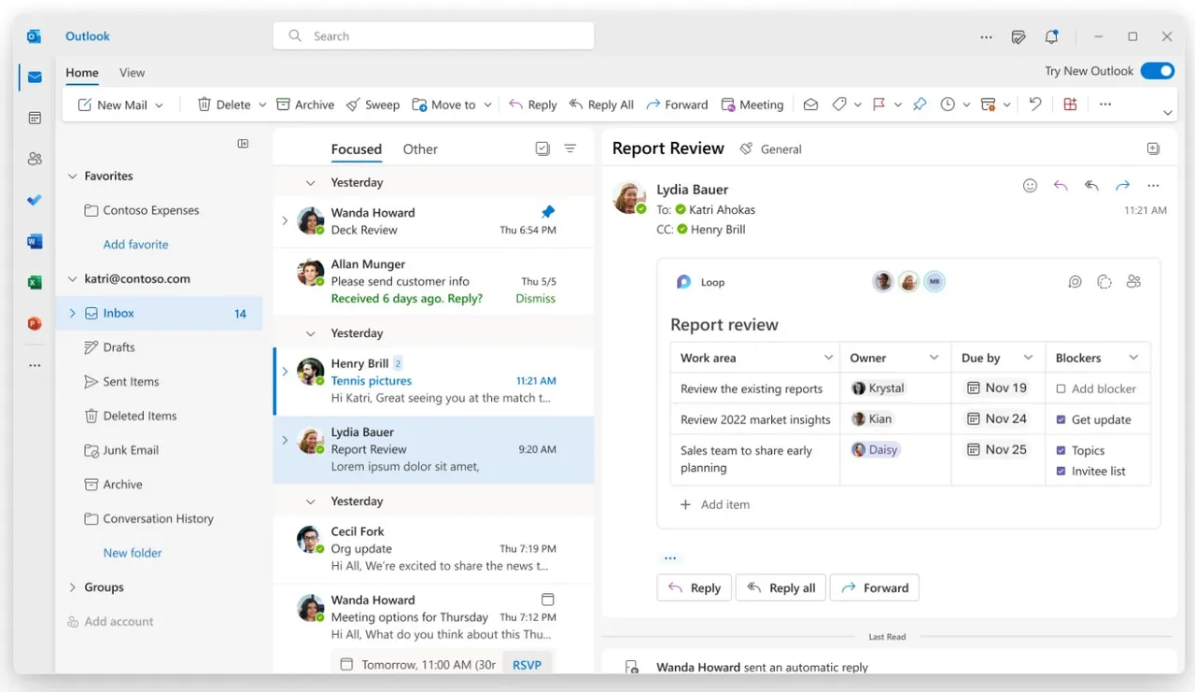

Image
Container
Prepackaged application
Running application

Slide 11


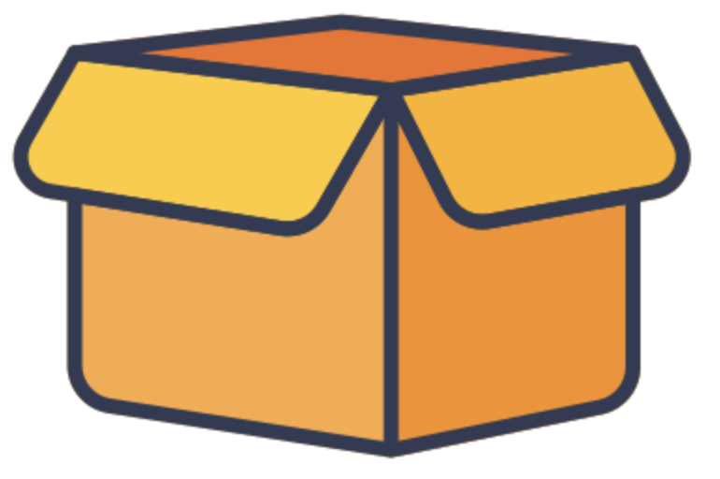

Docker
Images

Slide 12
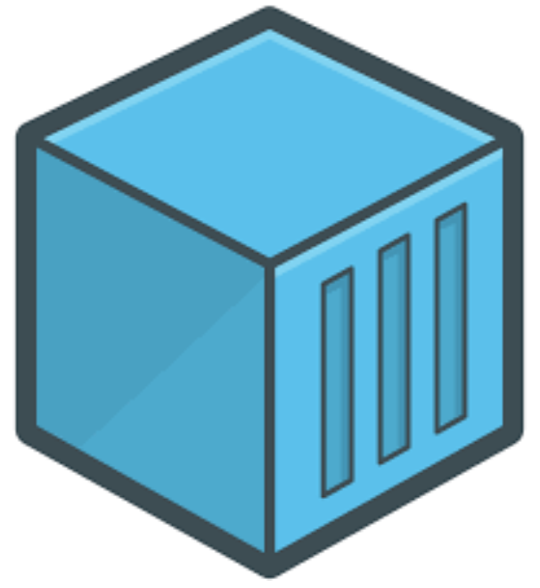
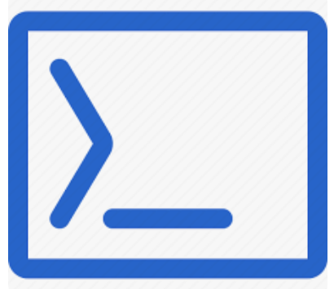
Docker
Images
Containers

Slide 13
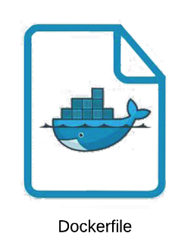

Download existing Image
Create your own image
Dockerfile
Template for building custom images
> docker pull mysql
FROM node:latest # Base image LABEL author="Marcos Duran" # Metadata about author ENV NODE_ENV=production # Environment variables ENV PORT=3000 COPY . /var/www # Copy source code to image WORKDIR /var/www # Set container working directory VOLUME ["/var/www"] # Sets volume paths RUN npm install # Executes commands EXPOSE $PORT # Expose internal port ENTRYPOINT ["npm", "start"] # Command to run on startup
> docker build -t ctl .

Slide 14
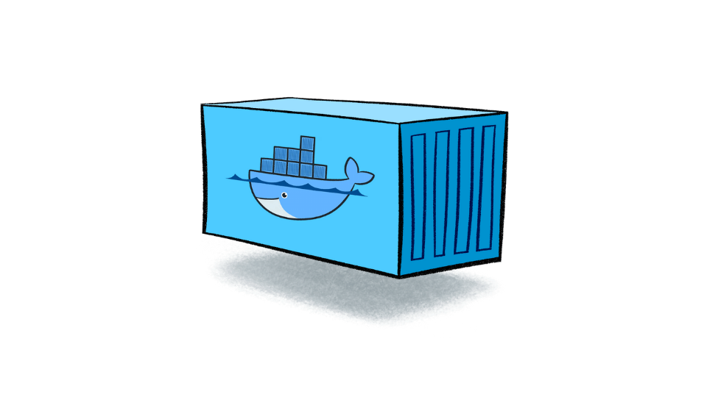

Running a container
> docker run --name ctlsite -p 8080:80 ctl

Slide 15
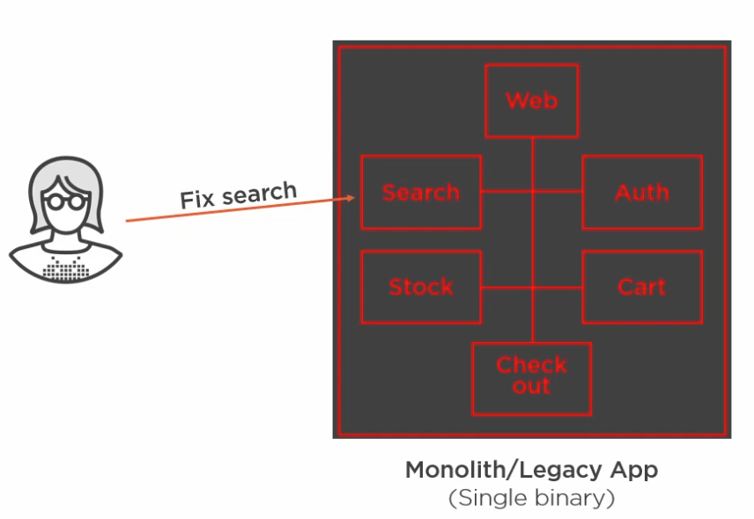
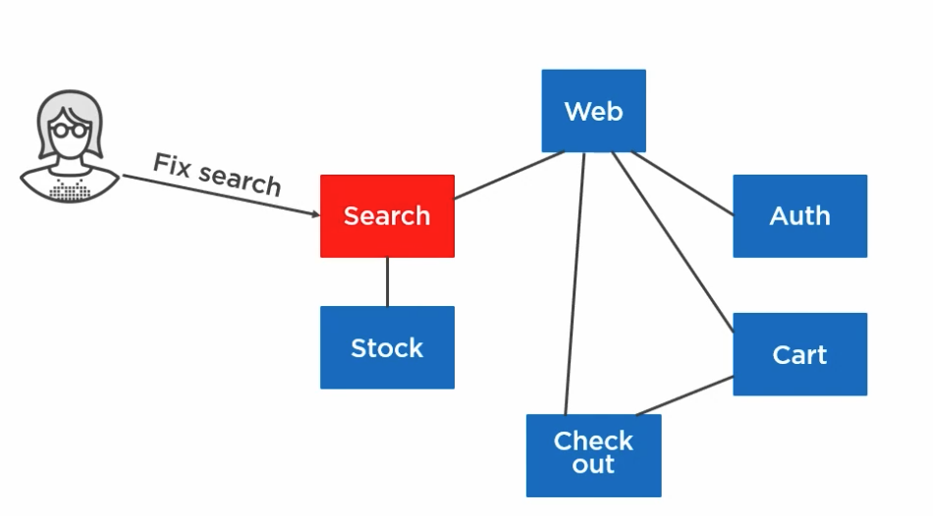
From Monolithic apps to Microservices and Cloud native
Monolithic app - Single binary (app) that takes care of everything.
Any fixes to any part of the app, means you are tweaking the whole code repository.
Microservices - Breaks the app into components (services) each with their own responsibility and they can all talk to each other.
Any fixes to a particular component will only take down that service, not the whole application.

Slide 16
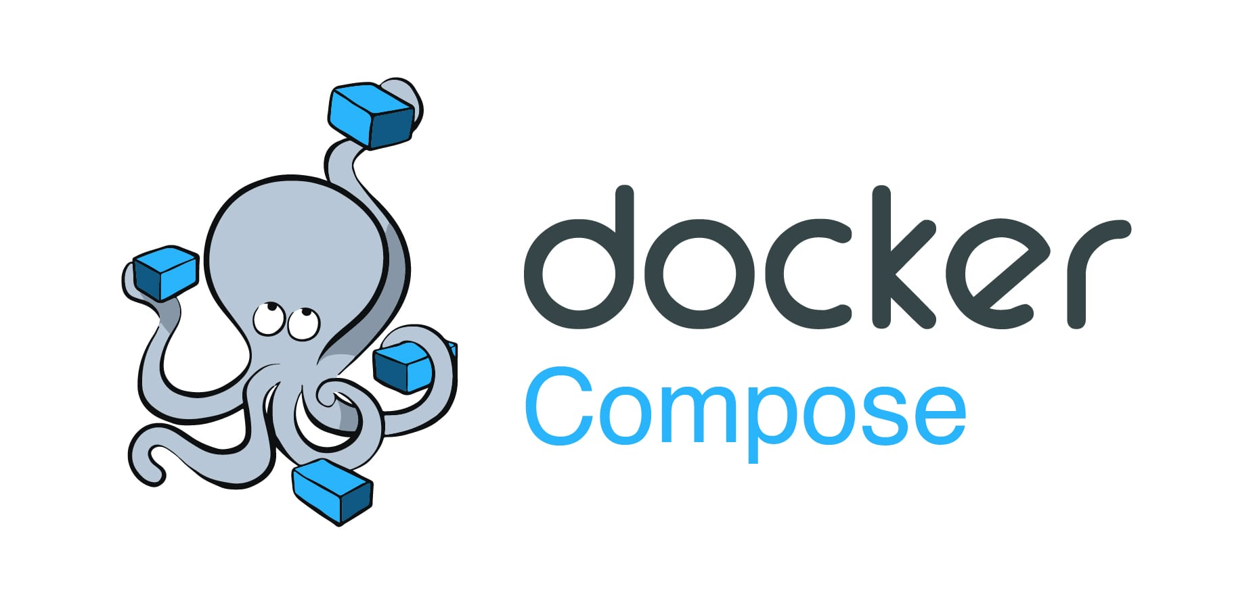

Slide 17
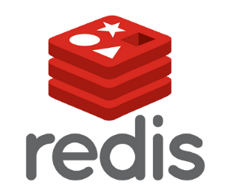

The need for docker-compose

Slide 18

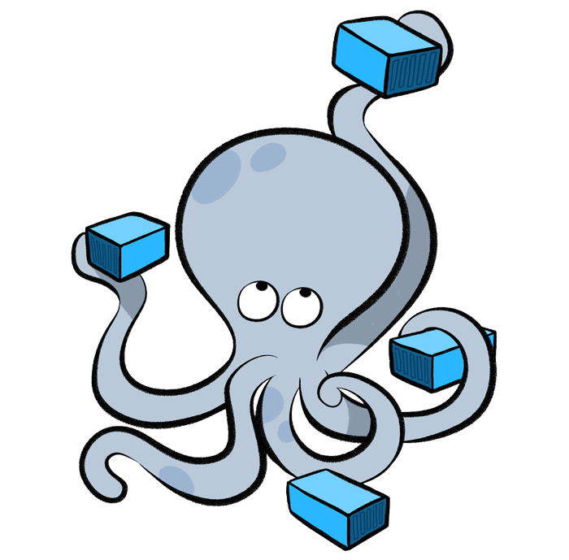
The need for docker-compose

Slide 19




The need for docker-compose

Slide 20
Docker compose
It’s a declarative way of writing docker commands, configurations, and how everything connects by describing the desired state in a configuration file - docker-compose.yml
You configure services (web server, databases, cache, etc) which will become running containers.
version: 3.7 # docker-compose version services: # configure each service (app, database, etc) as images that will become running containers. app: # App is a custom image that we will build that holds our code, libraries, dependencies, etc. build:
context: .
container_name: ctlsite
ports:
- 8080:80
environment:
APP: local
database: # Configuration for our database
image: mysql:8.0
container_name: ctldatabase
ports:
- 33006:3306 mail: # Configuration for our local email client
image: mailhog/mailhog
ports:
- 8025:8025

Slide 21
Docker compose
Manage the whole application lifecycle. Start, stop and rebuild services.
docker-compose build # Build all services configured in the docker-compose.yml file docker-compose up -d # Run all services/containers
docker-compose down # Shutdown our application docker-compose down --rmi all --volumes # Destroy - Shutdown and destroy all images and volumes associated with our app.
docker-compose ps # View the status of our running services
docker-compose logs # View a log report of all services within our app
docker exec -it ctlsite bash # Connect to our application (SSH/login into our application’s shell) docker exec -it ctldatabase mysql -uroot -p # Connect to our database (Access our mysql database to run SQL queries)
docker inspect [containerID] # Inspect a container configuration (IP, network, volumes, etc)

Slide 22
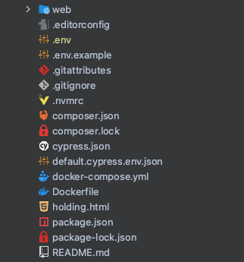
Remember!
Run docker compose commands where the docker-compose.yml file is located!

